Slide 1
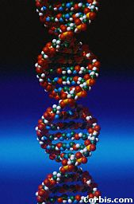
DNA
The genetic material of our bodies.
Notes:
1
All life on earth uses a chemical called DNA to carry its genetic code or blueprint. In this lesson we be examining the structure of this unique molecule.
{Point out the alligator’s eyes in the first picture.} By the way, can you make out what this is?
***************************************************************
[The goal of this presentation is to introduce high school biology students to the chemical structure of DNA. It is meant to be presented in the classroom while accompanying the teacher’s lecture, under the control of the teacher.]

Slide 2
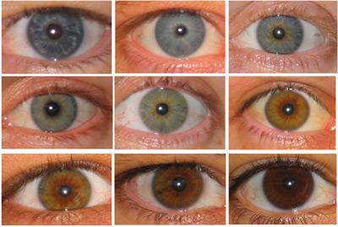
DNA Review & Basics
DNA is the genetic material of our bodies.
It contains our traits.
It is the molecule of
Heredity—it holds the
genes that parents
pass down to their offspring.
.

Slide 3
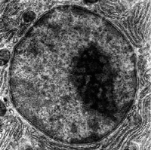
DNA Review & Basics
It is found in the nucleus
Of the cell.
2 Forms:
CHROMATIN: (spaghetti DNA) and CHROMOSOMES: (coiled up DNA).

Slide 4
Chromosomes and DNA
Our genes are on our chromosomes.
Chromosomes are made up of a chemical called DNA.

Slide 5
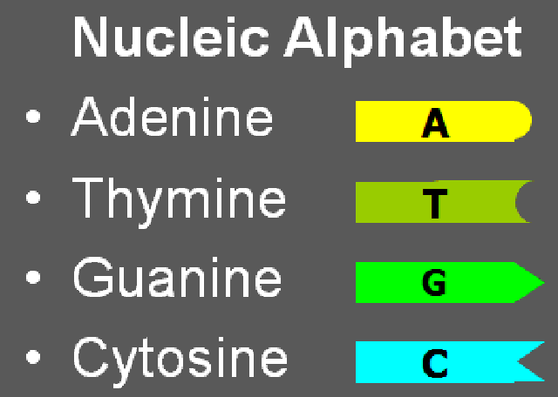
DNA Review & Basics
DNA is a set of instructions in a secret language made of the letters A T C & G.
ex: A G C T A C T C G T A
T C G A T G A G C A T

Slide 6
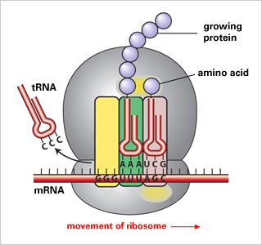
What Is DNA For?
This DNA language must be translated into the protein language for our body to use it.
DNA → mRNA → Protein Protein
Ribosome
Code for
Protein
(from DNA)

Slide 7
DNA
DNA is often called the “blueprint of life”.
In simple terms, DNA is a set of instructions for making proteins within the cell.
Notes:
7
{Ask students where the chromosomes are in this picture. Or ask them where the DNA is. Remind them that the mitochondria also have DNA.}

Slide 8
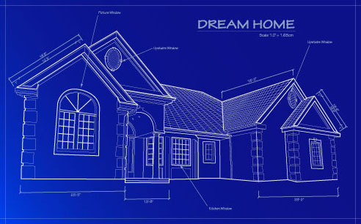
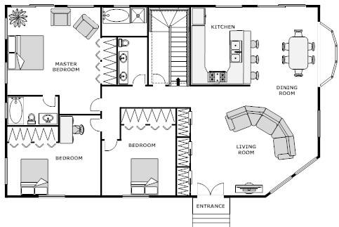
“Blueprints”
DNA is called the “blueprint of life”
As you are developing, DNA tells your body what to build
Your DNA determines your traits—what you look like, color of hair, how tall you are, etc.

Slide 9
Who has DNA?
All living things have DNA for instructions

Slide 10
Why do we study DNA?
We study DNA for many reasons, e.g.,
medical benefits such as cures for diseases,
Agriculture—better food crops (bigger fruit, disease resistant, etc.)
Notes:
10
{Show students a model of the double helix. Explain what a spiral is and a helix is.}

Slide 11
DNA Structure: The Double Helix
Type of organic molecule: DNA (deoxyribonucleic acid) is a Nucleic Acid.
Like all “N.A.’s” it is made of thousands of monomers called nucleotides.

Slide 12
Nucleotides
One nucleotide is made of 3 parts:
Phosphate
Sugar (deoxyribose)
Nitrogen Base (A, T, G, or C)
O -P O
O
O
C
O
Phosphate
C
C
Nitrogenous
base
C
C
Deoxyribose
Sugar (deoxyribose)
Notes:
12
We will take apart the DNA molecule to see how it is put together.
First, we will look at one strand.

Slide 13
One Strand of DNA
nucleotide
One strand of DNA is a polymer of nucleotides.
One strand of DNA has many millions of nucleotides.
Notes:
13
{Point to the 3-D mode, if you have one, to show the parts as you discuss them.}

Slide 14
One Strand of DNA
The backbone of the molecule is alternating phosphate and sugar (deoxyribose), a sugar, parts.
The teeth are nitrogenous bases (A, T, G, or C).
phosphate
deoxyribose
bases
Notes:
14
{Ask students where they have seen a similar molecule before in this class.
Answer: ATP . Emphasize that nucleotides are the basic building blocks or units of a DNA molecule and that a single molecule has many millions of nucleotides.}

Slide 15
Two Stranded DNA
DNA forms a “ladder” with two strands.
Notes:
15
These four bases are abbreviated by using their respective first letters.

Slide 16
Two Stranded DNA
v
DNA forms a “ladder” with two strands.

Slide 17
Two Stranded DNA
v

Slide 18
The Shape of the Molecule
DNA is a very long polymer.
The basic shape is like a twisted ladder or zipper.
This is called a double helix.

Slide 19
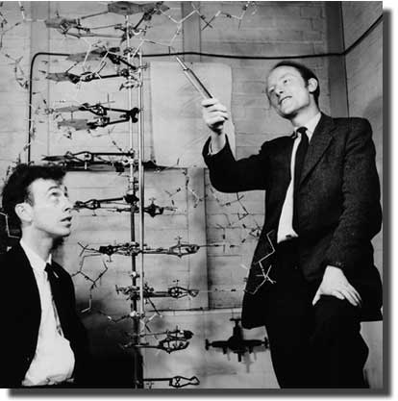
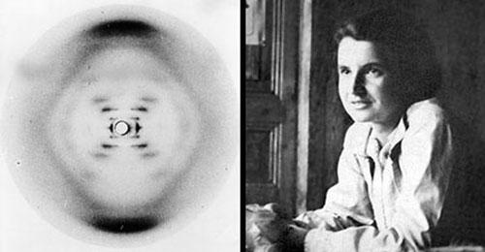
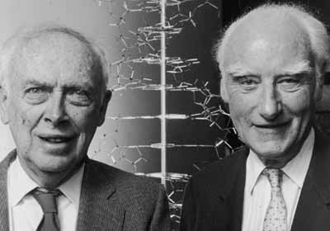
Watson & Crick: discovered the Double Helix shape of DNA.
Rosalind Franklin’s X-Ray picture of DNA
Used by Watson & Crick to discover the Double Helix
https://goo.gl/OoESm2
Recent photo: Watson/Crick

Slide 20
The Double Helix Molecule
The ladder “twists” to form a DOUBLE HELIX.
Notes:
20
If you unravel all the DNA in the chromosomes of one of your cells, it would stretch out 2 meters. If you did this to the DNA in all your cells, it would stretch from here to sun more than 400 hundred times!

Slide 21
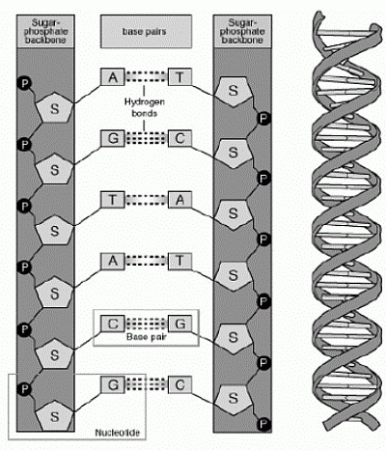
The sides of the DNA ladder are called: the sugar-phosphate backbone.

Slide 22
One nucleotide

Slide 23
Nucleotides are held together with hydrogen bonds.
These Bonds are weak.

Slide 24
→Bonds are weak.
→allows DNA to “unzip” easily for replication

Slide 25
Four nitrogenous bases
DNA has four different nitrogen bases:
A = Adenine
T = Thymine
G = Guanine
C = Cytosine
Notes:
25
Why is DNA called the blueprint of life?

Slide 26
These bases form pairs. They fit like puzzle pieces.
A
T

Slide 27
These bases form pairs. They fit like puzzle pieces.
A
T

Slide 28
Important:
Adenine and Thymine always join together
A T
Cytosine and Guanine always join together
C G
Chargaff’s Rule

Slide 29
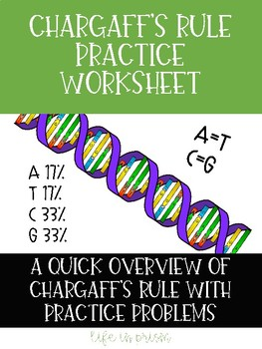

Slide 30
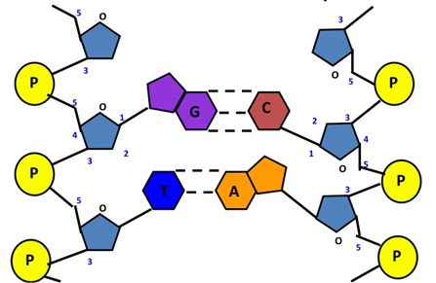

Slide 31
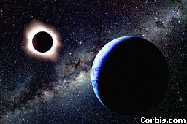
DNA by the numbers
Each cell has about 2 m of DNA.
The average human has 75 trillion cells.
The average human has enough DNA to go from the earth to the sun more than 400 times.
DNA has a diameter of only 0.000000002 m.
The earth is 150 billion m
or 93 million miles from
the sun.
Notes:
31
{Point to the 3-D model to show the parts as you discuss them.}

Slide 32
DNA vs. RNA (the differences)
DNA
Biomolecule Name:
Deoxyribonucleic acid
(named after the sugar)
RNA
Biomolecule Name:
Ribonucleic acid

Slide 33
DNA vs. RNA (the differences)
DNA
Double-Stranded
(double helix)
RNA
Single-Stranded

Slide 34
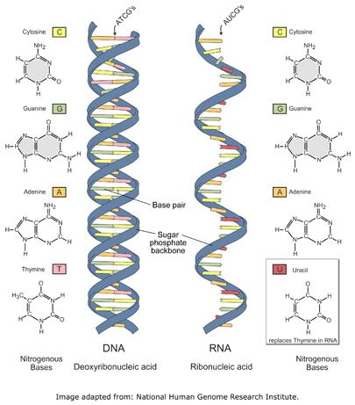

Slide 35
DNA vs. RNA (the differences)
DNA
Double-Stranded
(double helix)
Deoxyribose Sugar
RNA
Single-Stranded
Ribose Sugar

Slide 36
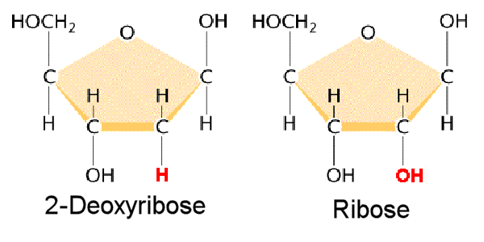
DNA RNA

Slide 37
DNA vs. RNA (the differences)
DNA
Double-Stranded
(double helix)
Deoxyribose Sugar
NITROGEN BASES:
A—T G—C
(contains T)
RNA
Single-Stranded
Ribose Sugar
NITROGEN BASES:
A—U G—C
(has U in place of T)

Slide 39
DNA vs. RNA (the differences)
DNA
Purpose:
Traits/genetics
(Information)
RNA
Purpose:
Tells the ribosomes what proteins to make.

Slide 40
DNA vs. RNA (the differences)
DNA
Location:
Always stays in the nucleus
RNA
Location:
Made in the nucleus
→sent as a message to the ribosomes in the cytoplasm

Slide 41
Thank You

